Slide 1

an interactive robotic system through voice commands
Presented by:
Mohammed Ibrahim Fallatah
Bandar abdulellah Hakami
Supervised by:
Dr.Tariq Alhmiedat
Department of Computer Science
Faculty of Computers & Information Technology
Tabuk University

Slide 2
Presentation Layout
Introduction
Problem Overview
Aims and objective
System concept
Related works
Main functionalities
System Approach And Tools
Future work.

Slide 3

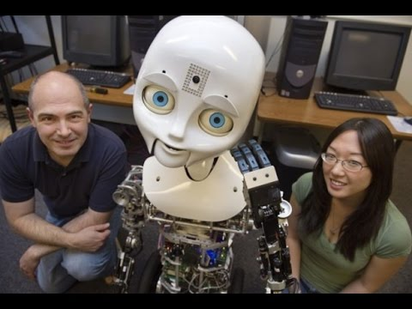
Introduction
Robots are a package of systems which include mechanical, electrical, computing and automation fields of technology which can be used to perform various tasks instead of humans in many different ways .
with increasing developments in this field robots can now be controlled with lesser direct human intervention to achieve a more natural interaction with.

Slide 4
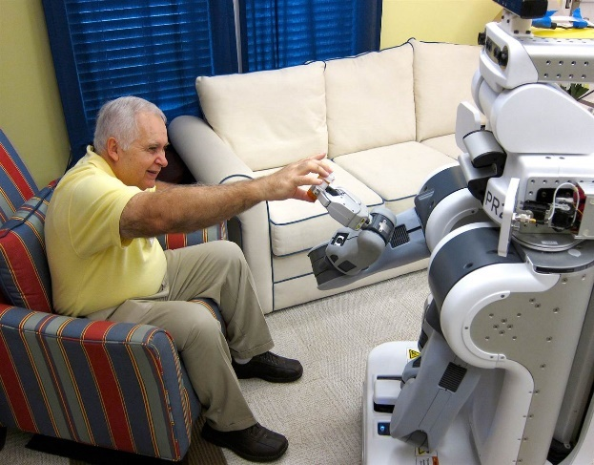
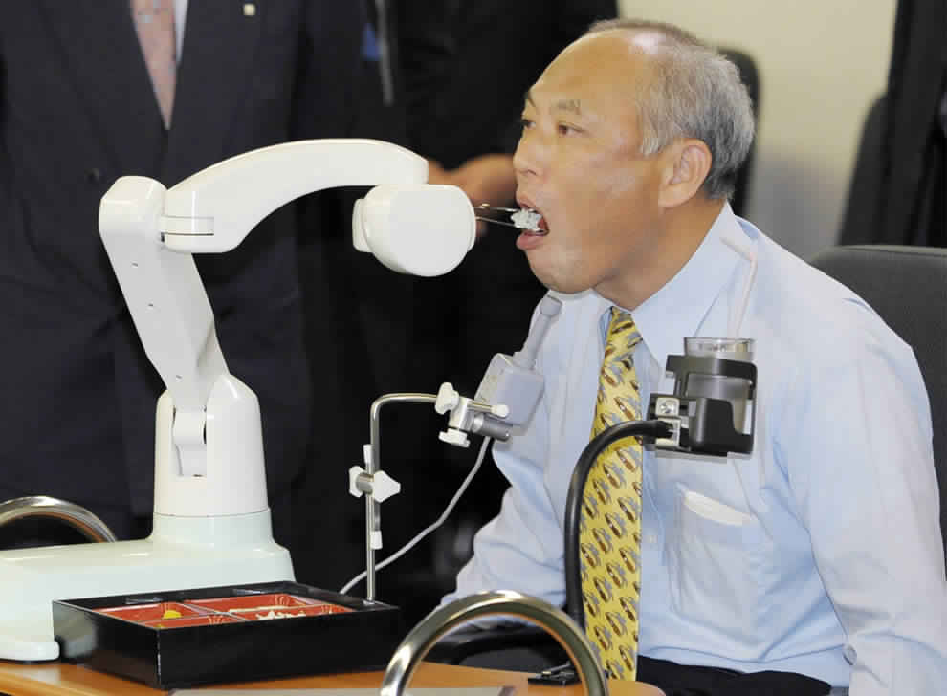

Problem Overview
Visually impaired people have some difficulties interacting with computer-based systems including robotics using the traditional user interface methods
old people may have difficulties in using computers, and also they might have some problem in dealing with robotics using the traditional methods. Therefore, they must be an interactive way for communicating with robots.

Slide 5
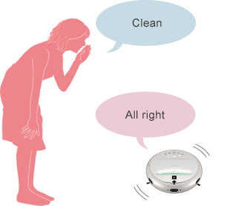

Aims and Objectives
Research the existing systems to obtain better understanding of the topic.
Design and implement a robotic system using Lego EV3 platform.
Design and implement robotic vehicle based on two-way voice commands
Design and implement Voice Controlled system to monitor and control the designed robotic system.
Test the efficiency of designed localization algorithm using Lego EV3 robot kit.

Slide 6
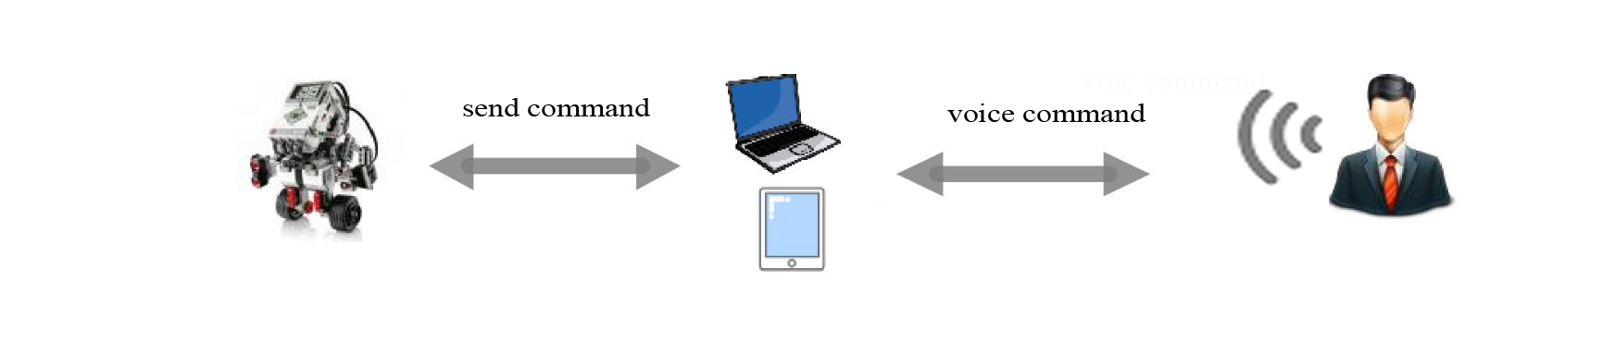
System Concept

Slide 7
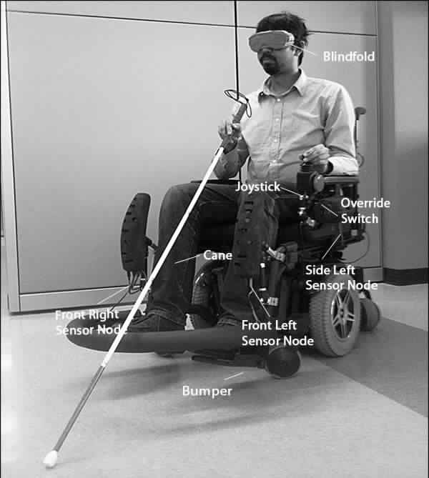
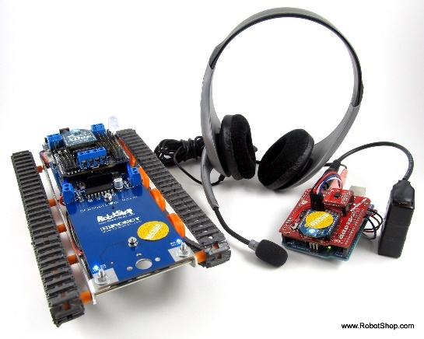
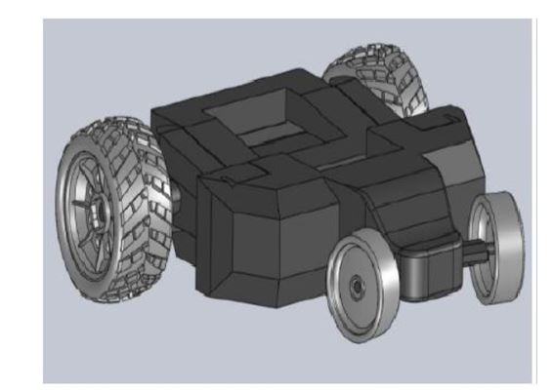
Related works
After very wide searching about existence voice command systems . We summarized the most important requirements which have to be taken into consideration:
Easy to use.
Not expansive.
Can work in noisy environment.
NavChair
Carlitos’ Projects Speech-Controlled Arduino Robot
SPEECH RECOGNITION SYSTEM FOR A VOICE CONTROLLED

Slide 8
Main Functionalities
1- manual controlling
The voice recognition system is also able to be controlled manually, which will allow the user to avoid any problems in case the voice recognition system is down for any reason and keep both the robot and the user safe .
2- voice controlling
Using the voice recognition library provided by Microsoft. system provide users the ability to control the robot by voice and allow them to interact with the system without even move there bodies.
3- Free Drive
the deigned robotic system has the feature of moving automatically and detectes the obstacles facing its way and adapts according to the given decision by the user,

Slide 9


System approach and tools
1- recognize and detect the spoken words by user
we used the voice recognition libraries provided by visual studio .Net Platform so the pc was the main controller
in which it’s responsible of detecting and processing the speech of the user then send the appropriate command to the robot

Slide 10
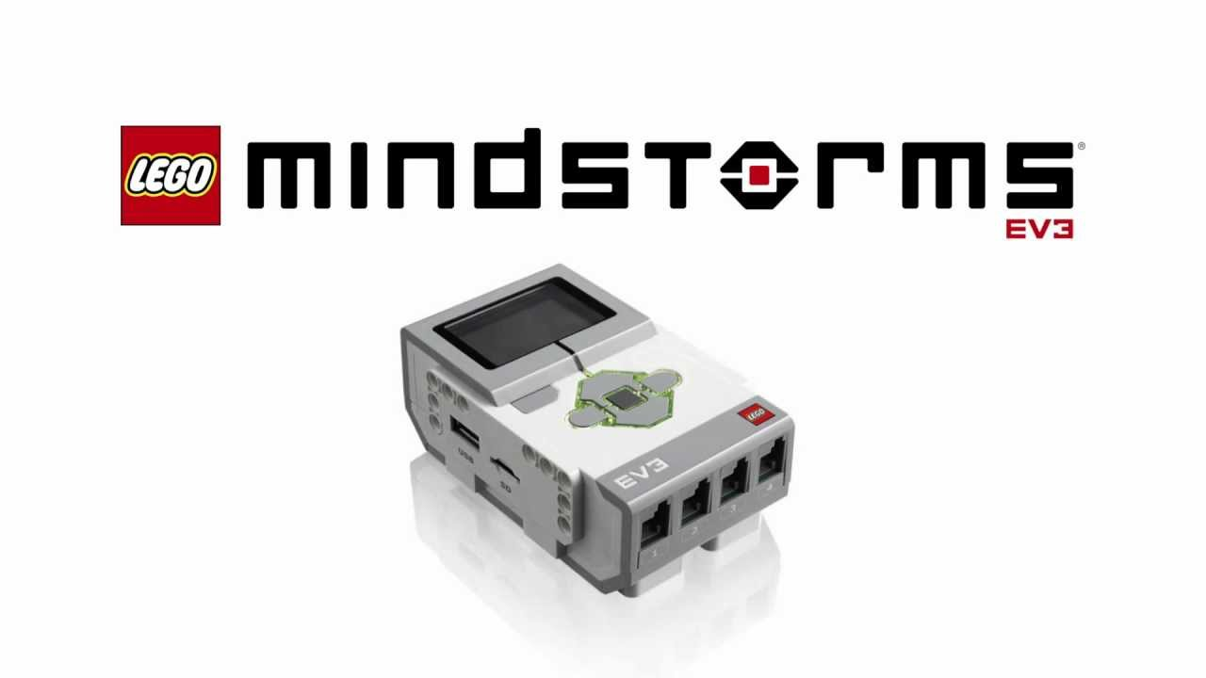
Cont…
2- Controlling the Robot
in order to move the robot and send the right command we needed to use lego minStorms Ev3 Libraries which allowed us to control (send , receive the commands) the robot through the Main Lego Controller (Brick)

Slide 11
Future works
We aim to design a voice commands robotic system which will be able to differentiate the users voices and act based on the privileges of each user.

Slide 12

Questions

